Slide 1


CONSERVE THE DEEP:MARINE LIFE CONSERVATION PLATFORM
Habibur Rahman Mahin
Shahria Sultana Elin
BSSE 1422
BSSE 1445
Supervised by: Dr.Zerina Begum
1

Slide 2

SRS document link
Conserve The Deep
2

Slide 3
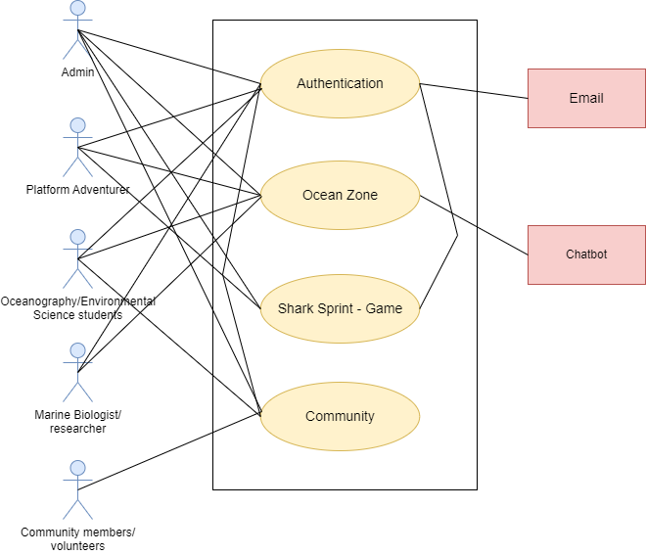
Use Case level 1
3

Slide 4
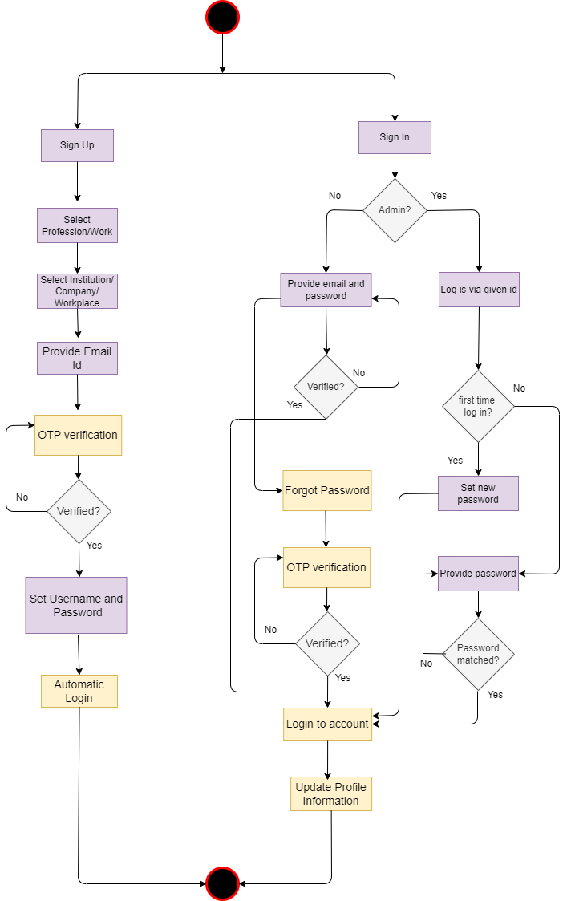
Activity Diagram level 1.1: Authentication
4

Slide 5

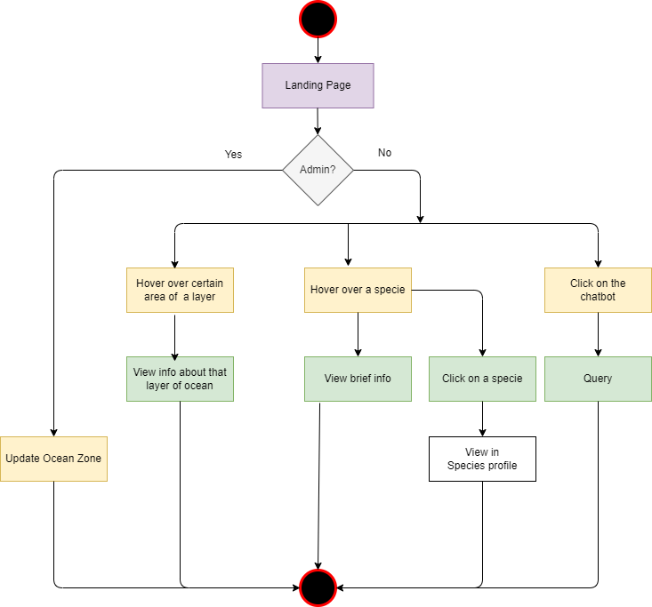

Activity Diagram
level 1.2: Ocean Zone
5

Slide 6

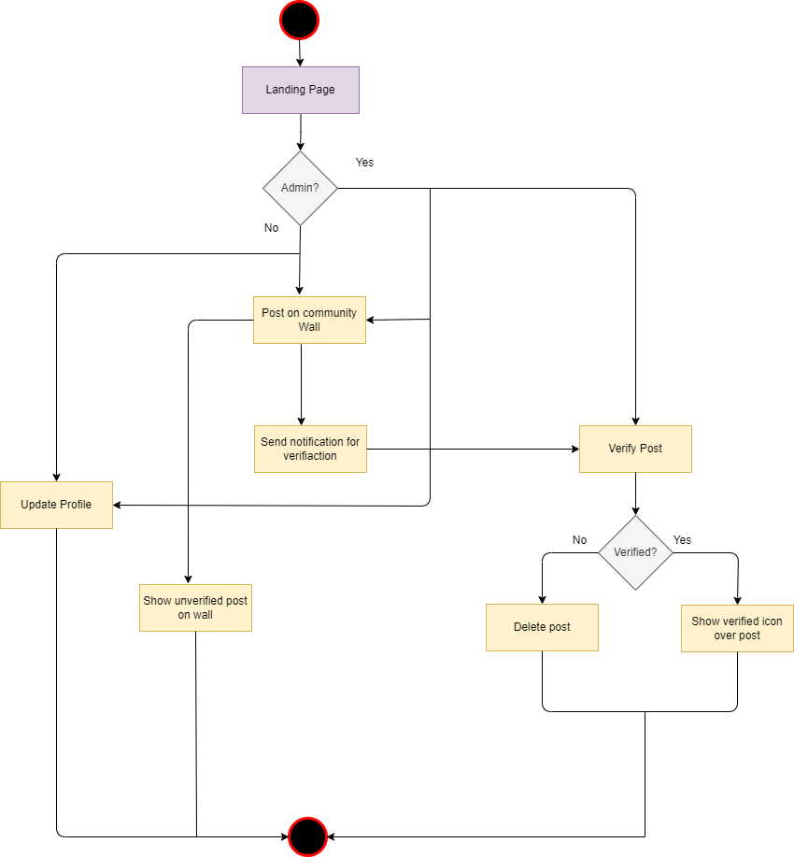
Activity Diagram level 1.4: Community
6

Slide 7

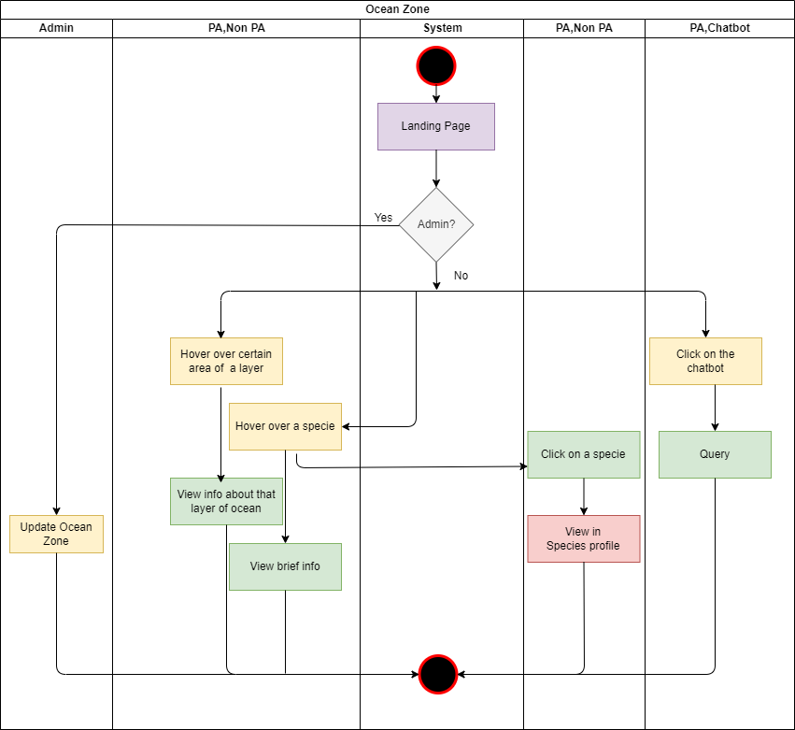

Swimlane Diagram level 1.2: Ocean Zone
7

Slide 8
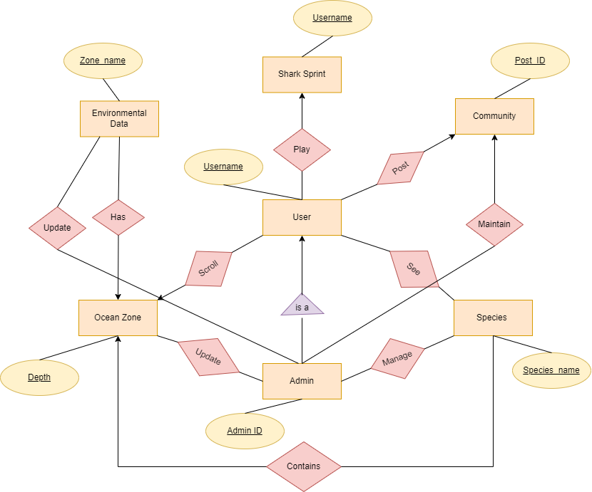

ER Diagram
8

Slide 9
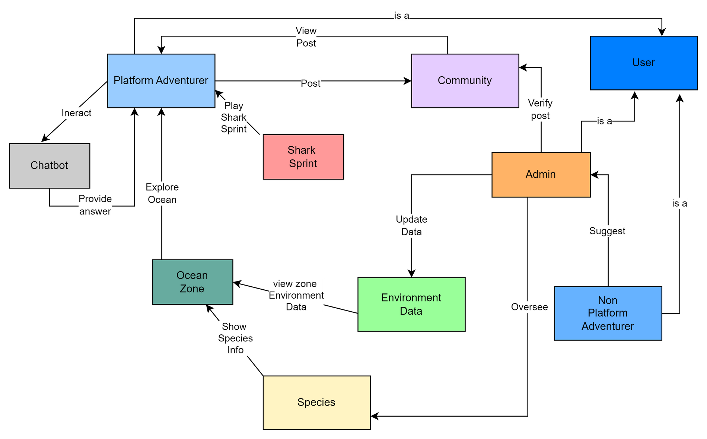
CRC Diagram
9

Slide 10
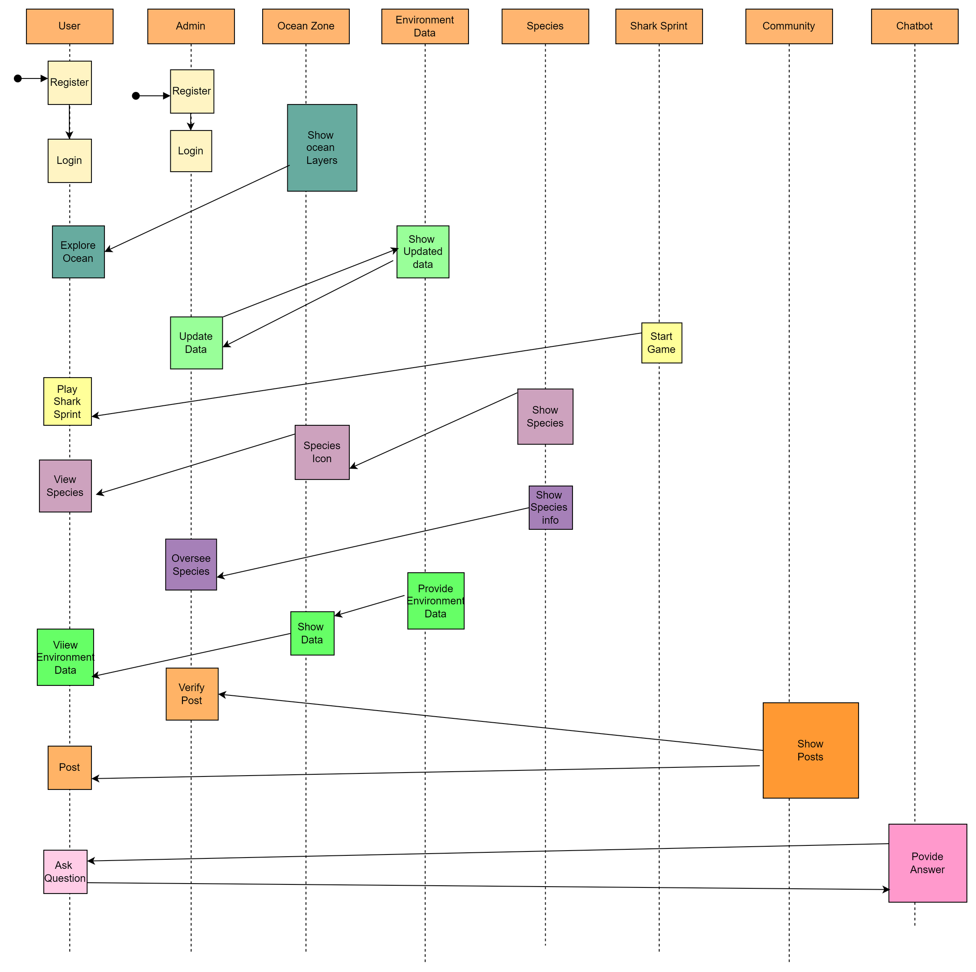
Sequence Diagram: part 1
10

Slide 11
Sequence Diagram: part 2
11

Slide 12
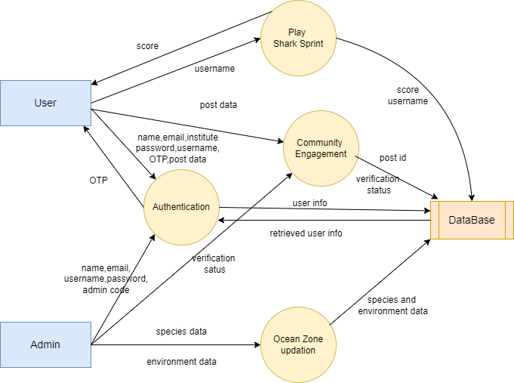
Data Flow Diagram level 1
12

Slide 13

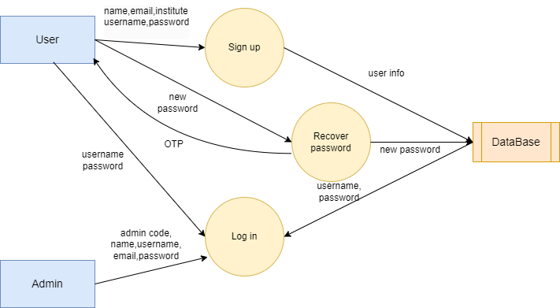
Data Flow Diagram level 2: Authentication
13

Slide 14

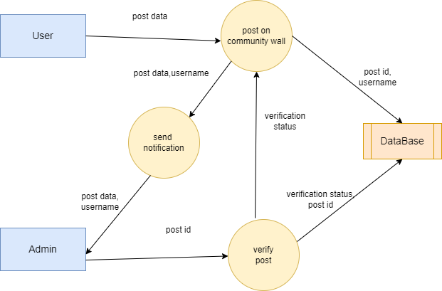
Data Flow Diagram level 2: Community Engagement
14

Slide 15
Thank You !
15

